Slide 1
Food Waste Analysis
Data Science Project Presentation
Name : Vaibhav Tripathy
25SCS1003005357
Submitted To: Varsha Srivastava

Slide 2
Problem Statement
Food waste is a major issue affecting economy and environment.
Understanding waste patterns can help reduce food waste.
Survey data is analyzed to identify waste causes.

Slide 3
Objectives
Analyze food waste behavior.
Identify main causes of waste.
Understand storage and consumption habits.
Prepare dataset for further analysis.

Slide 4
Dataset Description
Collected using Google Form survey.
Total responses: 100 participants.
Contains categorical and behavioral data.
Includes buying, storing, and waste habits.
Food_waste_analysis_100_responses.xlsx

Slide 5
Data Collection
Survey distributed among students and households.
Questions focused on food buying and waste habits.
Responses collected digitally.
Data exported to spreadsheet for analysis.

Slide 6
Data Cleaning
Removed incomplete or invalid responses.
Checked for duplicate entries.
Converted categorical responses into structured format.
Prepared clean dataset for analysis and visualization.

Slide 7
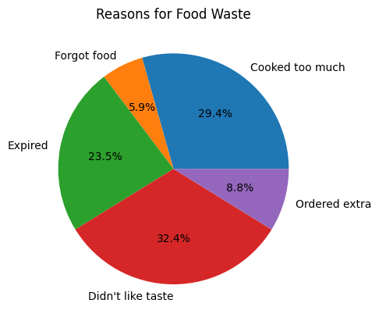
Chart: Reasons for Food Waste
Cooking excess food is major reason.
Food expiry and forgetting food also contribute.
Shows behavioral waste patterns.

Slide 8
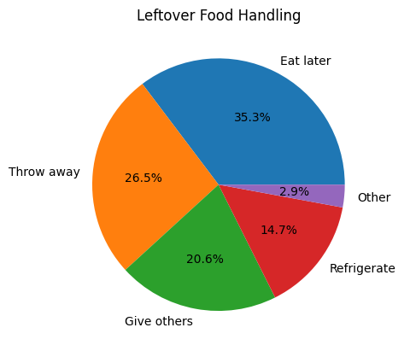
Chart: Leftover Handling
Many respondents eat leftovers later.
Some still throw food away.
Shows scope for improvement.

Slide 9
Past Work Done
Previous studies analyzed food waste using surveys and statistical methods.
Research identified major causes such as overcooking, improper storage, and expiry.
Some projects used visualization tools to understand waste patterns.
Machine learning has been applied in limited cases to predict food waste trends.
Awareness campaigns and behavioral analysis were also conducted.

Slide 10
Gap in Previous Work
Many studies used small datasets with limited participants.
Lack of real-time prediction and forecasting models.
Limited use of machine learning for accurate waste prediction.
Few studies focused on student and household combined behavior.
Need for better data cleaning, preprocessing, and predictive analysis.

Slide 11
Executive Summary
Food waste mainly driven by overproduction
Peak waste observed during weekends / high demand days
Key categories causing maximum waste identified
Model predicts waste trends with good accuracy
Recommendation: Optimize production using data insights

Slide 12
Business Problem / Use Case
Reduce food waste by 15–30%
Save operational costs
Improve sustainability
Better inventory management
Increase profit margins

Slide 13
Methodology
Collected food waste dataset from Excel Performed data cleaning (removed missing values and duplicates)Conducted Exploratory Data Analysis (EDA) to understand patterns Selected key features such as quantity and category Applied Machine Learning model for prediction Analyzed results and derived insights
This methodology helps in reducing food waste using data-driven decisions

Slide 14
Tools & Technologies Used
Microsoft Excel – for dataset collection and basic analysis
Python – for data processing and modelling
Pandas & NumPy – for data cleaning and manipulation
Matplotlib / Seaborn – for data visualization
Jupyter Notebook – for coding and implementation

Slide 15
Data Visualization Insights
Used visualization techniques to understand food waste patterns Compared food prepared vs food consumed Identified high waste food categories Observed trends across different days/time Helped in better understanding of data through visual representation
“Visualization made it easier to identify patterns and draw meaningful insights.

Slide 16
Challenges Faced
Handling missing and inconsistent data in dataset Difficulty in selecting relevant features for analysis Limited dataset size affecting accuracy Understanding and applying machine learning model Interpreting results and drawing meaningful insights
These challenges were resolved through data cleaning, practice, and proper analysis.

Slide 17
Recommendations
Use data-driven planning to reduce over production Monitor daily food waste and adjust quantity accordingly Focus on reducing waste of perishable food items Improve demand forecasting using historical data Create awareness about food waste management
These recommendations can help in reducing food waste and improving efficiency.

Slide 18
Impact / Benefits
Reduces overall food waste Helps in better resource utilization Improves decision-making using data Reduces operational costs Promotes environmental sustainability
This project contributes to both economic savings and environmental protection.

Slide 19
Limitations
Limited dataset size may affect accuracy
Data may not represent real-world scenarios completely
Some important factors (like weather, demand changes) not included
Model predictions depend on data quality
Results may vary with different datasets

Slide 20

Thank You!

